Slide 1

Constrained Deep Learning for Modeling and Control of Buildings
Jan Drgona
Collaborators: Elliott Skomski, Soumya Vasisht,
Aaron Tuor, Vikas Chandan, Draguna Vrabie

Slide 2
Model Predictive Control Challenges
Modeling
Physics-based modeling is expensive and time-consuming, uncertainties are unavoidable
Purely data-driven models lack operational safety guarantees, and do not generalize well
Optimization: translation to a solver language
Multiple customized methods for dealing with constraints (soft, hard)
Multi-objective, convexification, regularization, convergence issues
Computational limitations of control hardware
Online optimization computational requirements
Cloud deployment vs embedded optimization
Acceptance by operators
Installation: data mapping, sensor discovery, tuning
Interpretability, interaction, trust
Performance Measurement & Verification
Drgona J., J. Arroyo, I.C. Figueroa, D. Blum, K. Arendt, D. Kim, and E.P. Olle, J. Oravec, M.Wetter, D.L.Vrabie, L. Helsen. 2020. "All You Need to Know About Model Predictive Control for Buildings." Annual Reviews in Control, September 29, 2020
Notes:
There are four main challenges that must be overcome to make MPC cost-effective
The Training and calibration of models – must be automated
The translation of the optimization problems to a solver language – must be automated
To address the computational limitations of embedded hardware - must reduce computing need without trading performance
Acceptance by building operators – complex decisions must be translated to interpretable decision rules

Slide 3

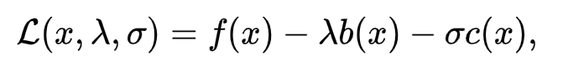
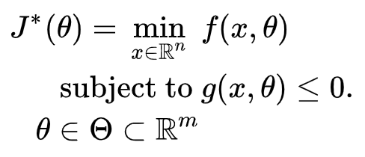

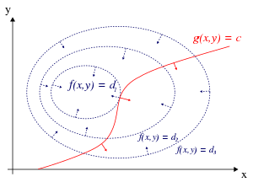
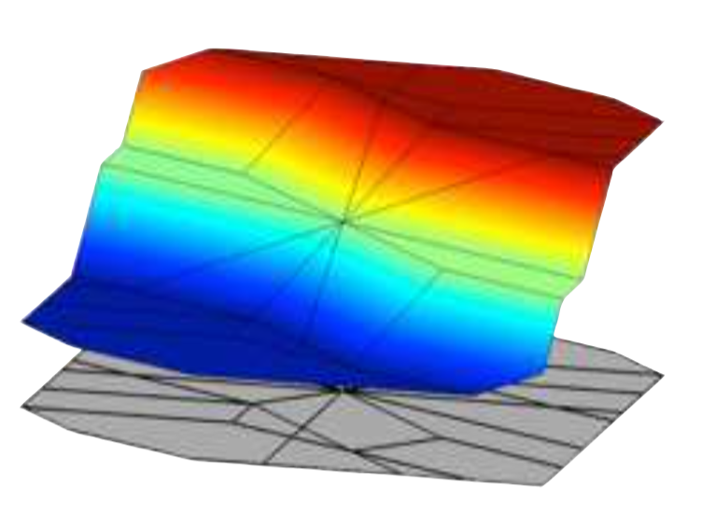


Formulations of Constrained Optimization Problems
Standard form
Lagrangian form
Parametric programming
Machine learning
“online” optimization
Single solution for
given parameter values
“online” optimization
Using soft constraints
Instead of hard constraints
“offline” optimization
Obtains a solution map
for a set of parameters
“offline” optimization
Obtains a model (map)
for a set of datapoints
Notes:
There are four main challenges that must be overcome to make MPC cost-effective
The Training and calibration of models – must be automated
The translation of the optimization problems to a solver language – must be automated
To address the computational limitations of embedded hardware - must reduce computing need without trading performance
Acceptance by building operators – complex decisions must be translated to interpretable decision rules

Slide 4
Formulations of Constrained Optimization Problems
Standard form
Lagrangian form
Parametric programming
Machine learning
“online” optimization
Single solution for
given parameter values
“online” optimization
Using soft constraints
Instead of hard constraints
“offline” optimization
Obtains a solution map
for a set of parameters
“offline” optimization
Obtains a model (map)
for a set of datapoints
Data-driven differentiable parametric optimization: Combining principles of
Lagrangian formulation, parametric programming and ML
Notes:
There are four main challenges that must be overcome to make MPC cost-effective
The Training and calibration of models – must be automated
The translation of the optimization problems to a solver language – must be automated
To address the computational limitations of embedded hardware - must reduce computing need without trading performance
Acceptance by building operators – complex decisions must be translated to interpretable decision rules

Slide 5
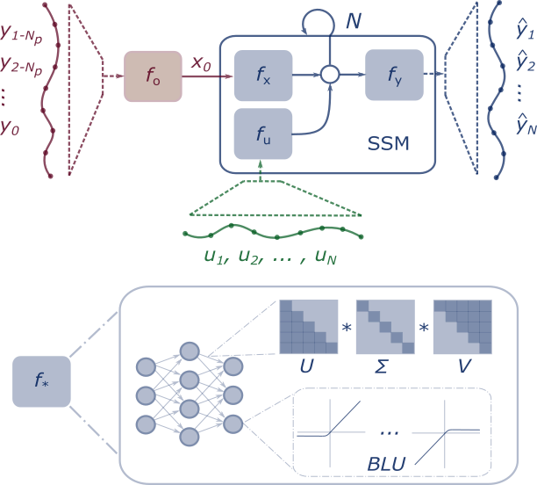
Method: Differentiable Predictive Control (DPC)
Stage I: System Identification
Stage II: Policy Optimization
Fixed SSM Parameters
System ID
Loss
Reference
Tracking
Loss
Dataset of perturbed system measurements
Synthetic random dataset of references and system states
Notes:
Integrate Deep Learning with Optimization-Based Control
Machine learning models that respect physical laws
Incorporate domain knowledge in their architectures
Incorporate domain knowledge with auxiliary loss functions
Use cases
Optimal control
Predictive maintenance
Surrogates for inverse problems
Forecasting for high level planning
Configurable optimization
Sequential
Joint
Alternating
Online updates
Scalable inference
Fast sampling rates
Limited computational resources
High dimensional state space
Long prediction horizons

Slide 6
Stage I: Constrained Neural State Space Models
Machine learning models that respect physical laws and constraints
Nonlinear system identification
Incorporate domain knowledge in their architectures
Incorporate domain knowledge with auxiliary loss functions
Block-structured neural state-space model
Neural state estimator
Learnable activation functions
Structured linear maps
Constraints enforcing penalties
Aaron R Tuor, Ján Drgona, Draguna L Vrabie Constrained Neural Ordinary Differential Equations with Stability Guarantees, Code release: https://github.com/pnnl/neural_ODE_ICLR2020

Slide 7
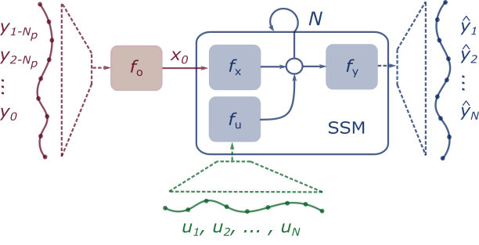
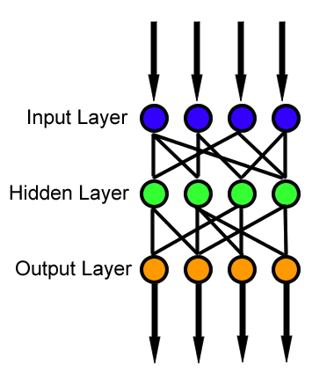
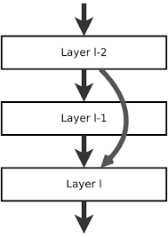
Neural Network Block Structure and Components
Multi-layer perceptron
Function approximator
Composed linear maps and nonlinear activation functions
Model complicated functions
adding depth (more layers)
and/or width (more nodes)
Residual Neural Network
Adds shortcut connections
Easier to optimize
Mitigates vanishing gradient
Recurrent Neural Network
Adds recurrences from previous inputs
Sequential modeling
Can model time delay
f

Slide 8
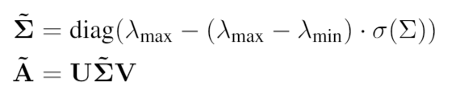
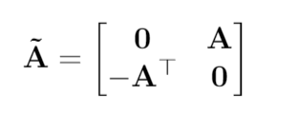
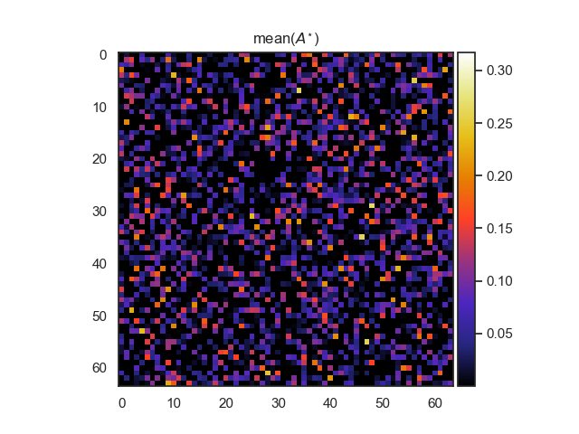
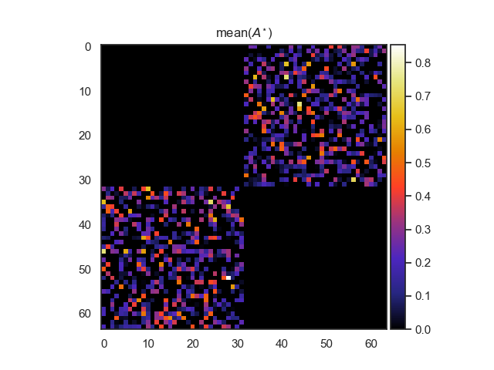
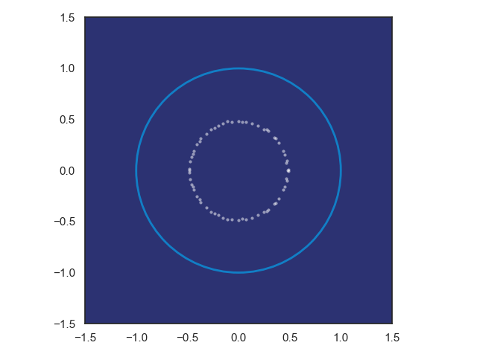
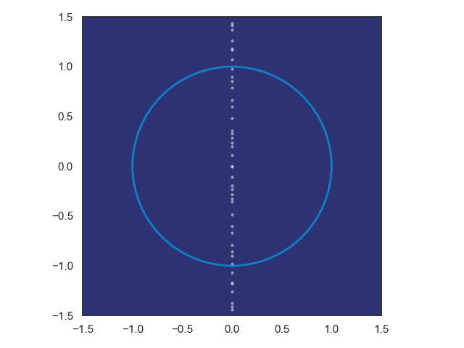
Structured Linear Maps with Eigenvalue Constraints
SVD factorization
Hamiltonian weight
Jiong Zhang, et al., Stabilizing Gradients for Deep Neural Networks via Efficient SVD Parameterization, 2018. Eldad Haber and Lars Ruthotto, Stable Architectures for Deep Neural Networks 2017 Jan Drgona, Aaron Tuor, Soumya Vasisht, Elliott Skomski, Draguna Vrabie, Spectral Analysis and Stability of Deep Neural Dynamics, arXiv:2011.13492 Code: https://github.com/pnnl/slim

Slide 9
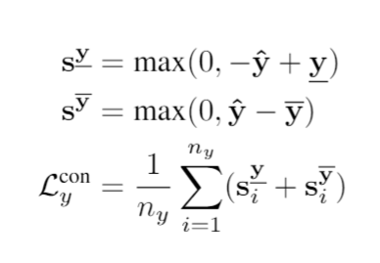
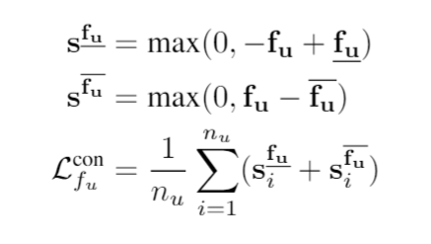
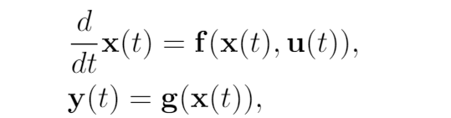
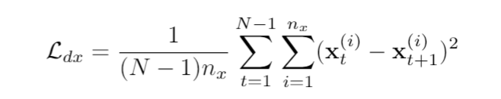
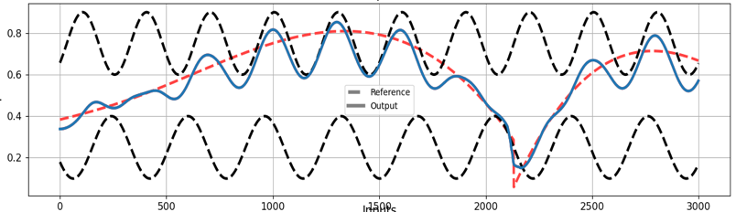
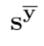
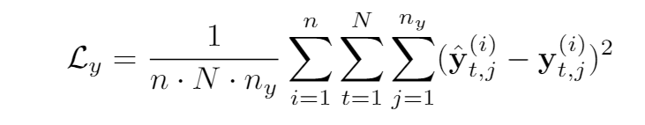
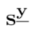
Training Loss Includes System Knowledge
Bound influence of input and bound output to physical range
Partially observable non-autonomous system
Data needs:
Predicted State Smoothing
Optimize N-step prediction horizon MSE

Slide 10
Modeling Thermal Dynamics
Ján Drgona, Aaron R. Tuor, Vikas Chandan, Draguna L. Vrabie, Physics-constrained Deep Recurrent Neural Models of Building Thermal Dynamics, NeurIPS Climate Change AI Workshop, 2020
Implementation in PyTorch https://github.com/pnnl/neuromancer/tree/NeurIPS2020

Slide 11
Real World Data: Office Building

Slide 12
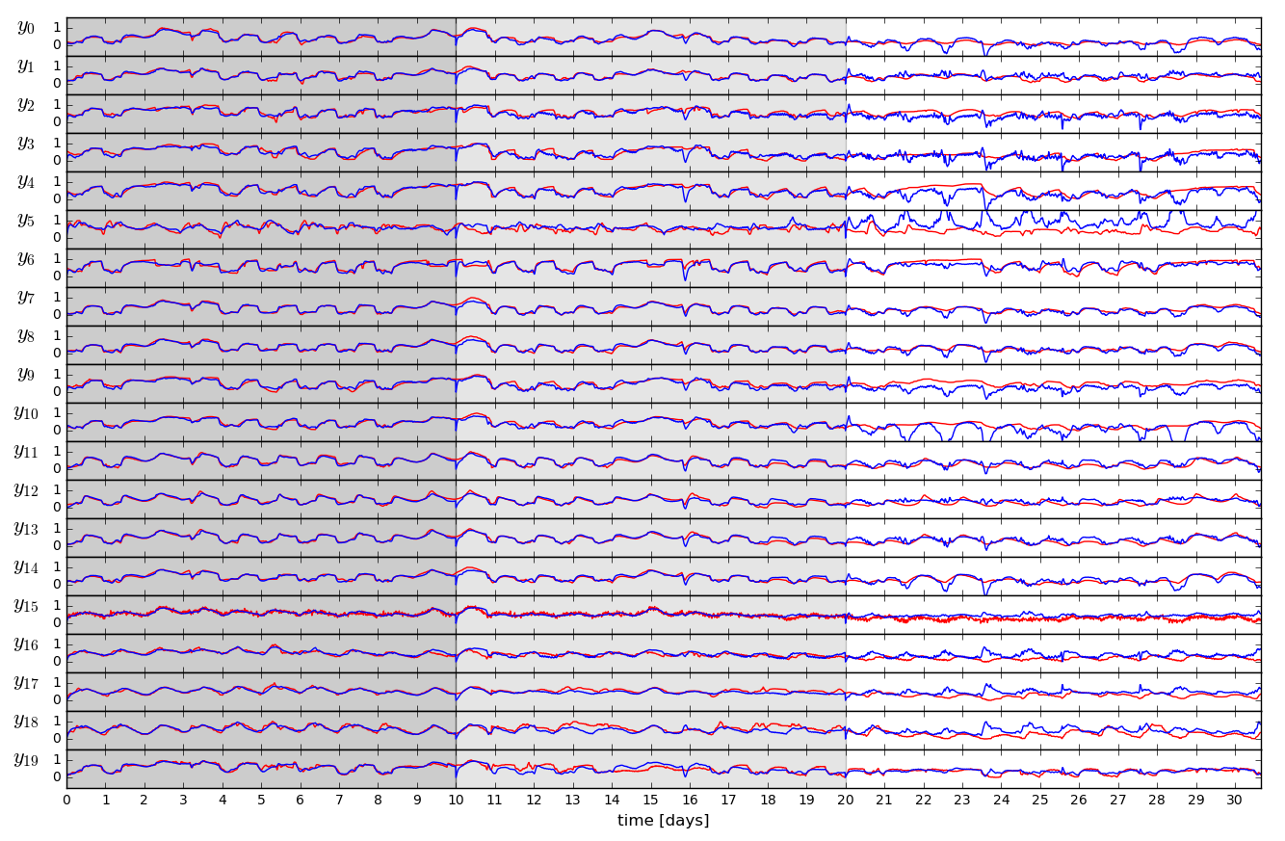
Open-loop Trajectories of Linear Dynamics Model

Slide 13
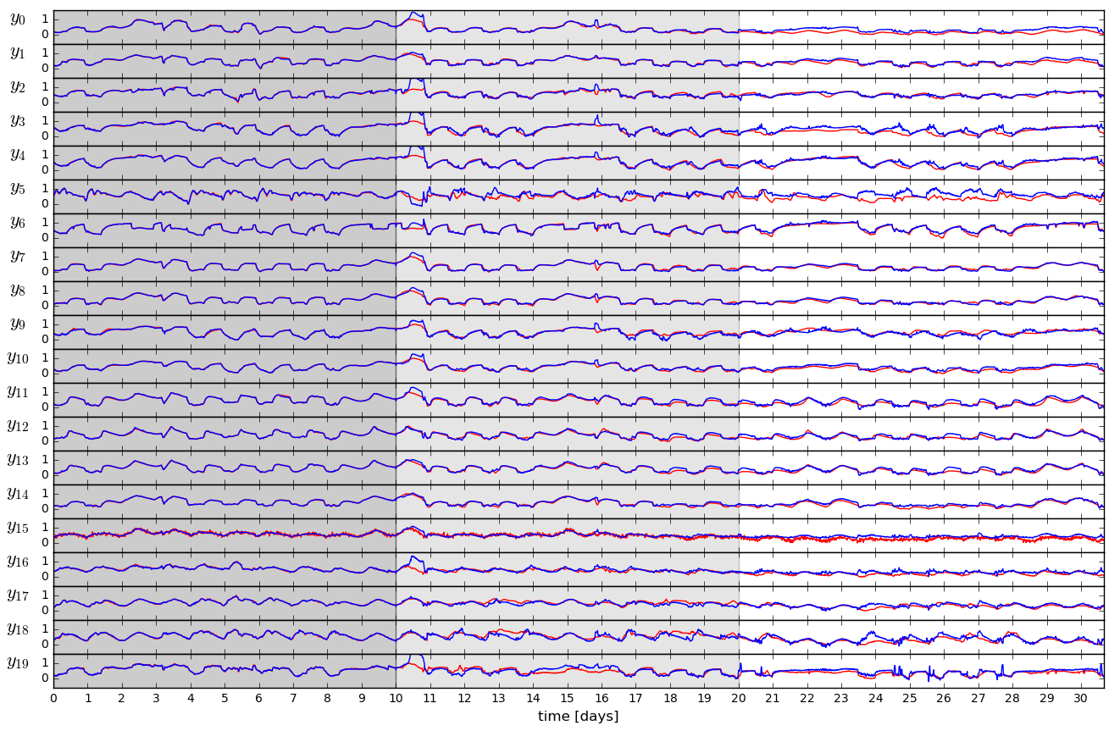
Open-loop Trajectories of Neural Dynamics Model

Slide 14
Deep Learning of Model-based Control Policies
Objectives
Cut the development and deployment cost of model-based control
Learn safe and robust control policies with adaptive updates
Embedded hardware implementation
Approaches
Approximate MPC
Imitation learning of supervisory MPC
Differentiable Predictive Control
Supervised policy learning in closed loop guided by learned model

Slide 15
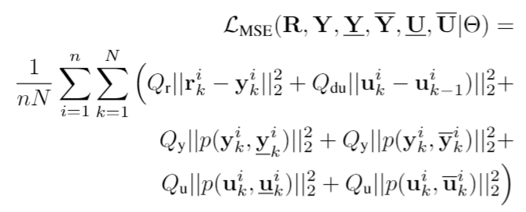
Stage II: Differentiable Predictive Control (DPC)
Generic method for constrained model-based control
Can be trained end-to-end from time series dataset
Nonlinear constrained optimal control
Neural system dynamics model
Predictive reference tracking
Constraints satisfaction
Balancing conflicting objectives
Economic objectives
Scalability beyond the limitations of explicit MPC
Explicit neural network-based control policy
Linear scalability w.r.t. memory footprint, number of policy parameters, and required construction time
Potential for wide adoption in large-scale control systems with limited computational resources and fast sampling rates
Jan Drgona, et al., Differentiable Predictive Control: An MPC Alternative for Unknown Nonlinear Systems using Constrained Deep Learning https://arxiv.org/abs/2011.03699
Jan Drgona, Aaron Tuor, Draguna Vrabie, Constrained Physics-Informed Deep Learning for Stable System Identification and Control of Unknown Linear Systems https://arxiv.org/abs/2004.11184

Slide 16
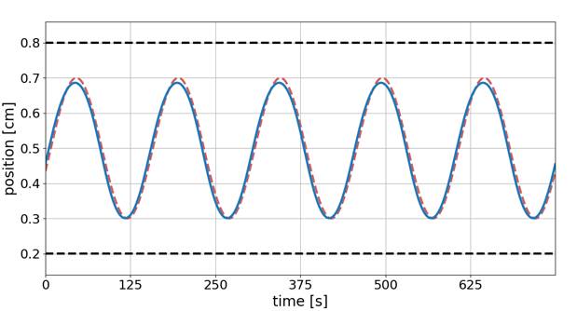
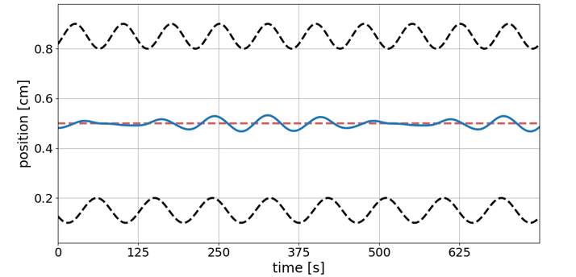
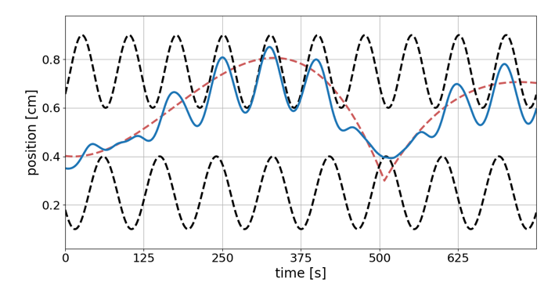
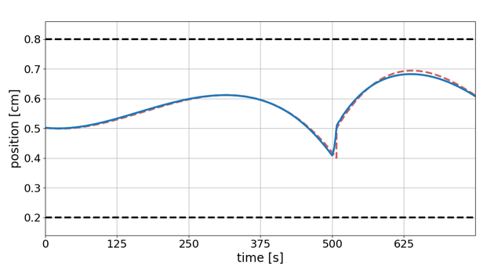
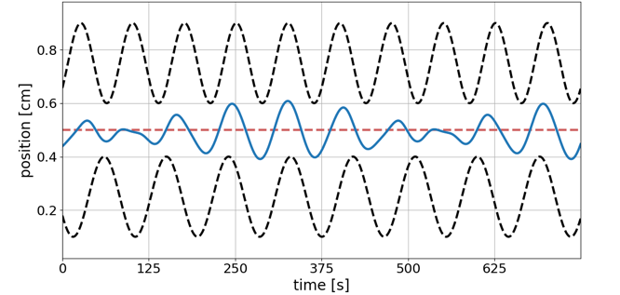
Capability: Computationally efficient performance optimization with constraints
--- Reference trajectory
--- Constraints
__ Controlled trajectory
Reference tracking performance
Response to constraint tightening
Balancing conflicting objectives
Notes:
Computationally efficient performance optimization with operational safety constraints

Slide 17
Model Predictive Control vs Differentiable Predictive Control
DPC = Formulation of MPC problem as a constrained deep learning model
Drgona J., Tuor A., Vrabie D., Constrained Physics-Informed Deep Learning for Stable System Identification and Control of Linear Systems, Code release: https://github.com/pnnl/deps_arXiv2020

Slide 18
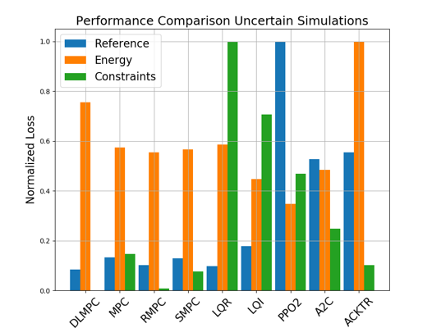
Comparison of DPC with MPC, LQR, and RL
Closed loop trajectories. Top: controlled state (orange), internal model predictions (green), given reference (dashed blue), and constraints (dashed black). Middle: control action (blue) and bounds (dashed black). Bottom: disturbances
Control performance comparison in simulations with parametric and additive uncertainties. Control Strategies: MPC, Robust MPC , Stochastic MPC, LQR, LQI, A2C: Asynchronous, deterministic variant of Advantage Actor Critic, ACKTR: Actor Critic using Kronecker-Factored Trust Region, PPO2: Proximal Policy Optimization
Drgona J., Tuor A., Vrabie D., Constrained Physics-Informed Deep Learning for Stable System Identification and Control of Linear Systems, Code release: https://github.com/pnnl/deps_arXiv2020

Slide 19
Embedded Implementation of DPC
Flexy-Air system sketch with Raspberry-Pi controller
Performance comparison: reference (red dashed), position controlled with PI controller (green), explicit model predictive control (purple), constrained differentiable predictive control (blue) and constraints (black-dashed). Bottom figures show the fan speed controls
Jan Drgona, Karol Kis, Aaron Tuor, Draguna Vrabie, Martin Klauco, Differentiable Predictive Control: An MPC Alternative for Unknown Nonlinear Systems using Constrained Deep Learning; arXiv:2011.03699

Slide 20


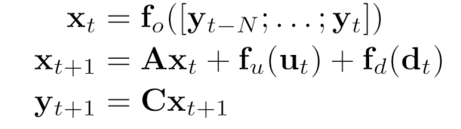
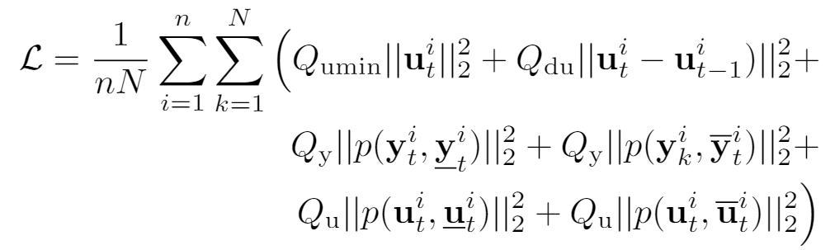
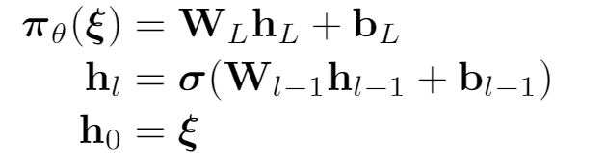
DPC for Building Control
Economic MPC loss function
model
policy
Jan Drgona, Aaron Tuor, Elliott Skomski, Soumya Vasisht, Draguna Vrabie, Deep Learning Explicit Differentiable Predictive Control Laws for Buildings, under review IFAC NMPC 2021

Slide 21
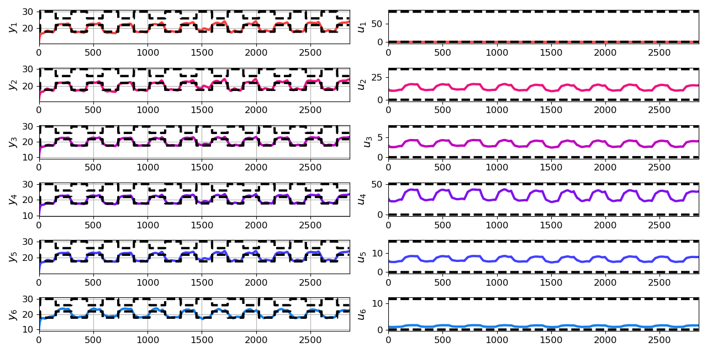
Closed-loop Performance of DPC on Learned Model without Plant-Model Mismatch
Jan Drgona, Aaron Tuor, Elliott Skomski, Soumya Vasisht, Draguna Vrabie, Deep Learning Explicit Differentiable Predictive Control Laws for Buildings, under review IFAC NMPC 2021

Slide 22
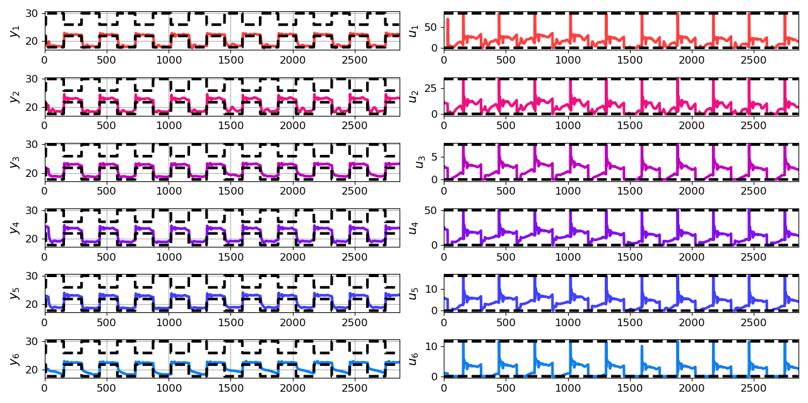
Closed-loop Performance of DPC on Emulator Model with Plant-Model Mismatch
Jan Drgona, Aaron Tuor, Elliott Skomski, Soumya Vasisht, Draguna Vrabie, Deep Learning Explicit Differentiable Predictive Control Laws for Buildings, under review IFAC NMPC 2021

Slide 23
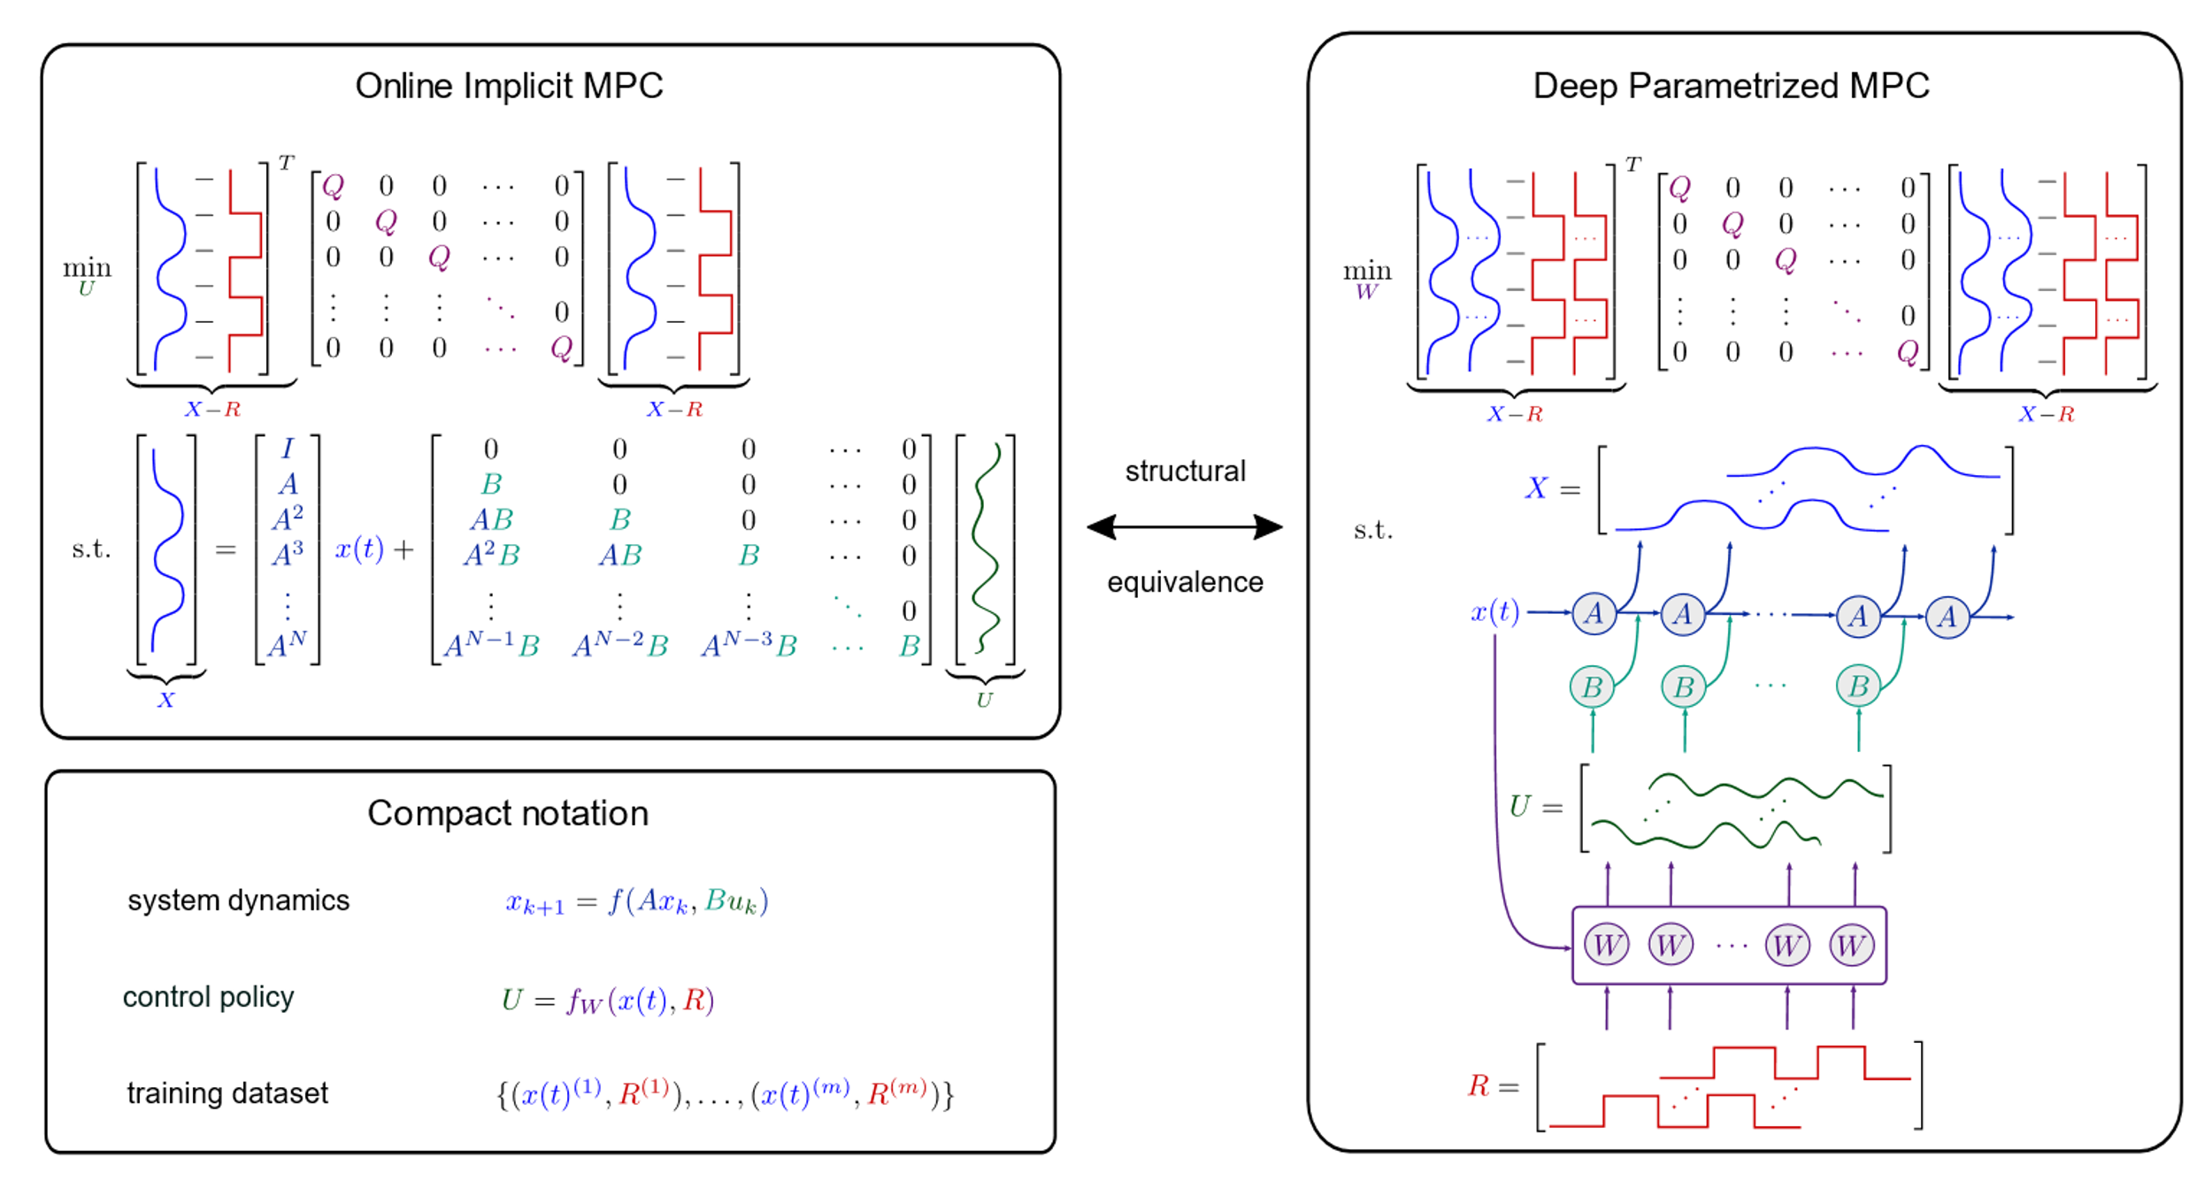
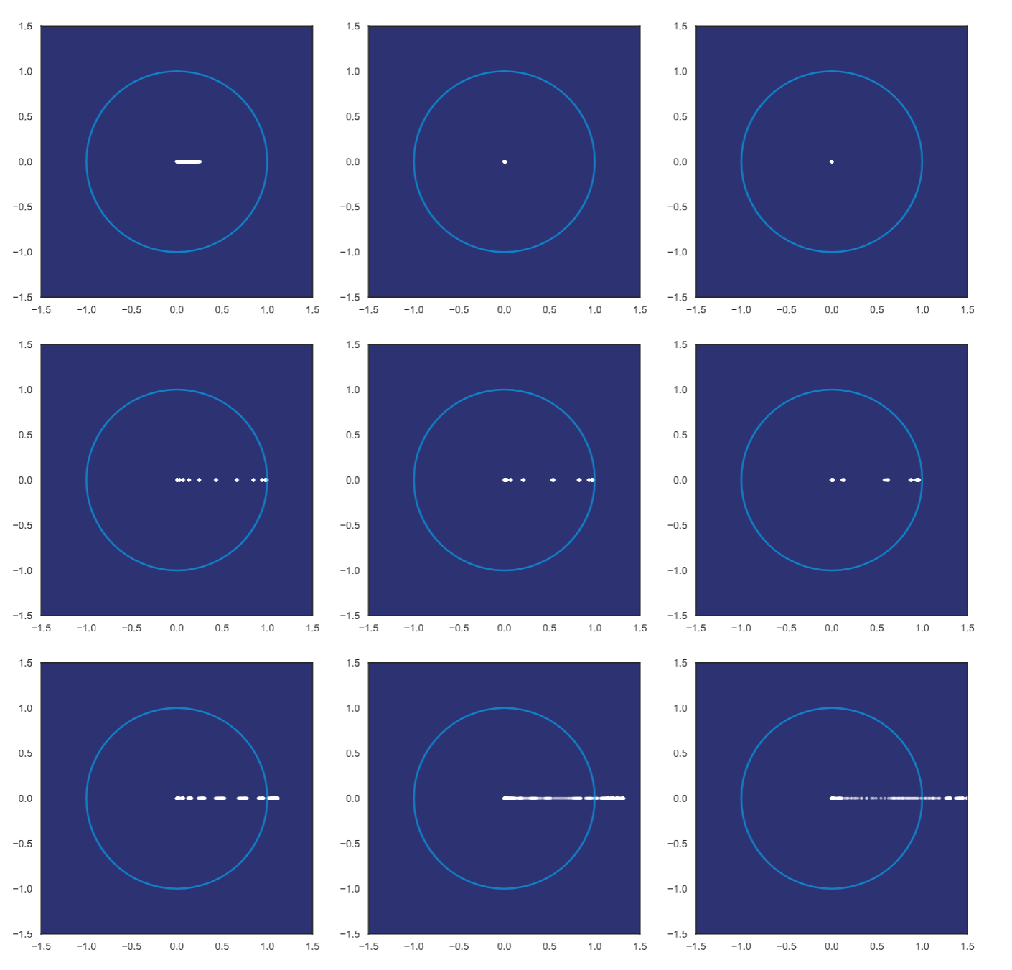
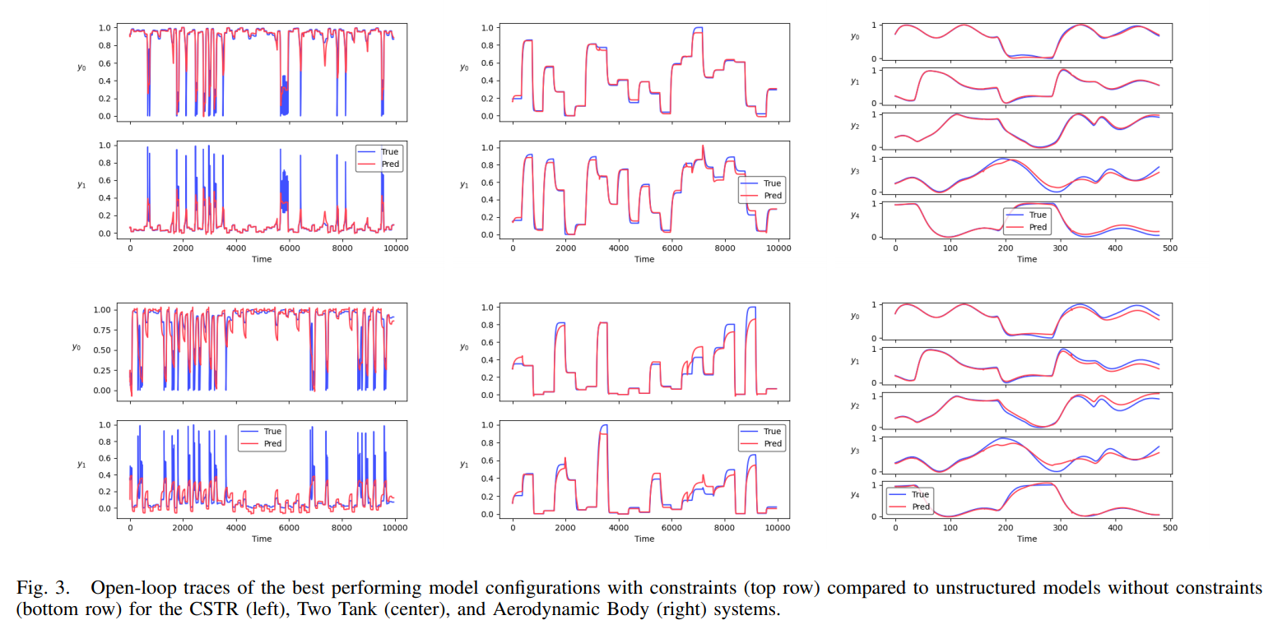
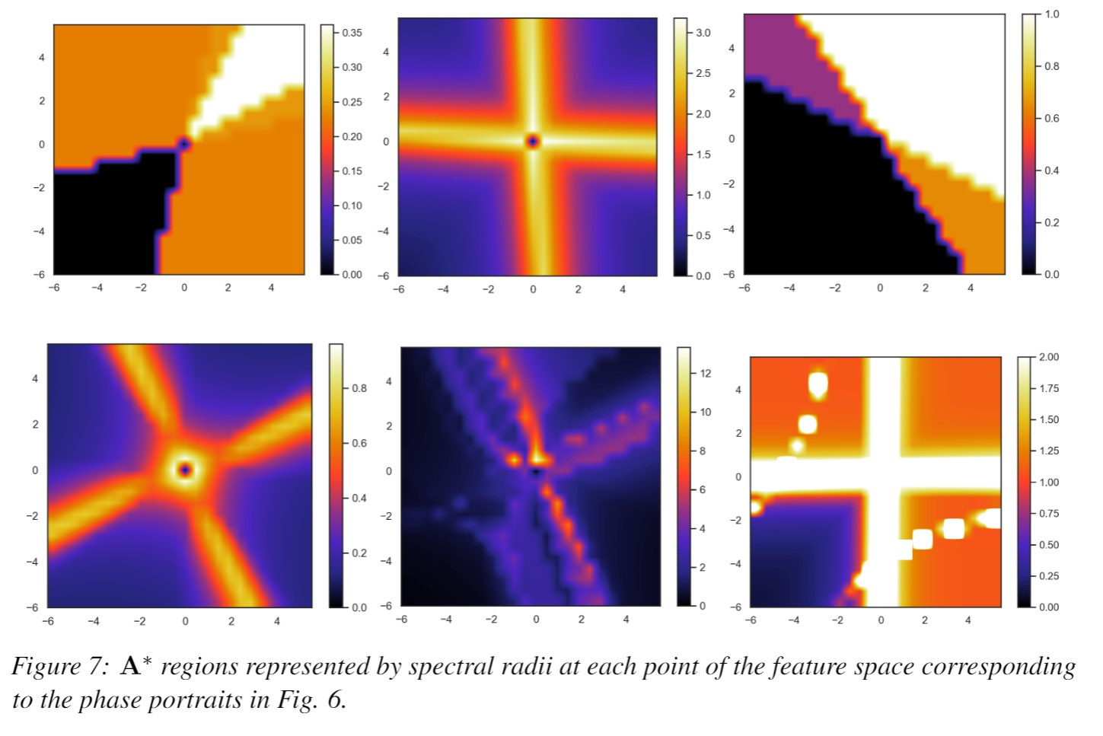
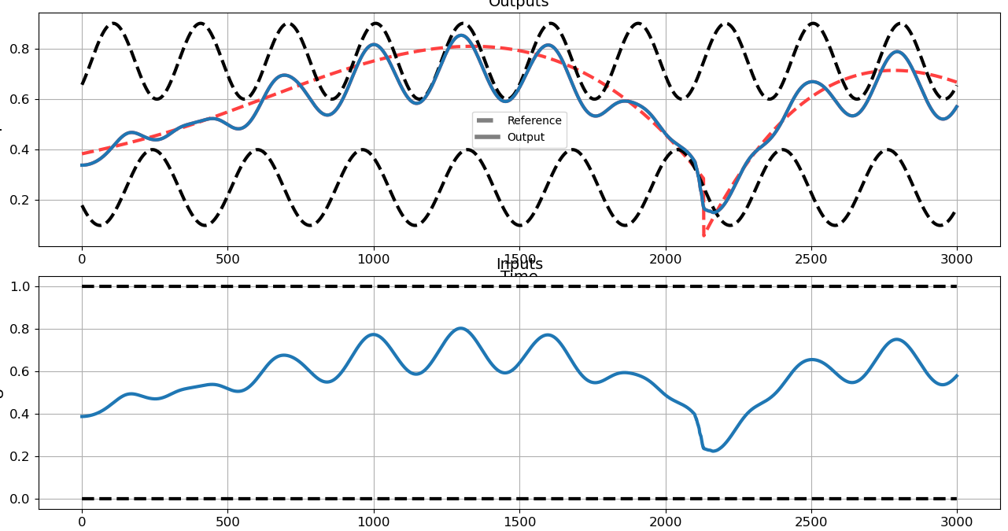
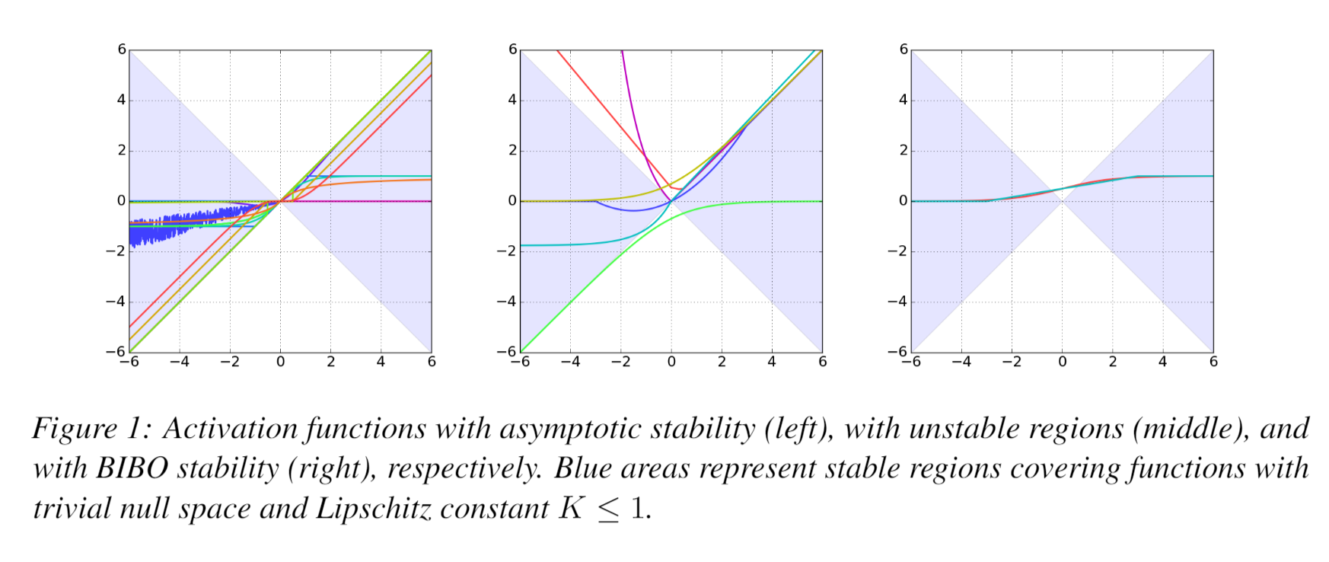
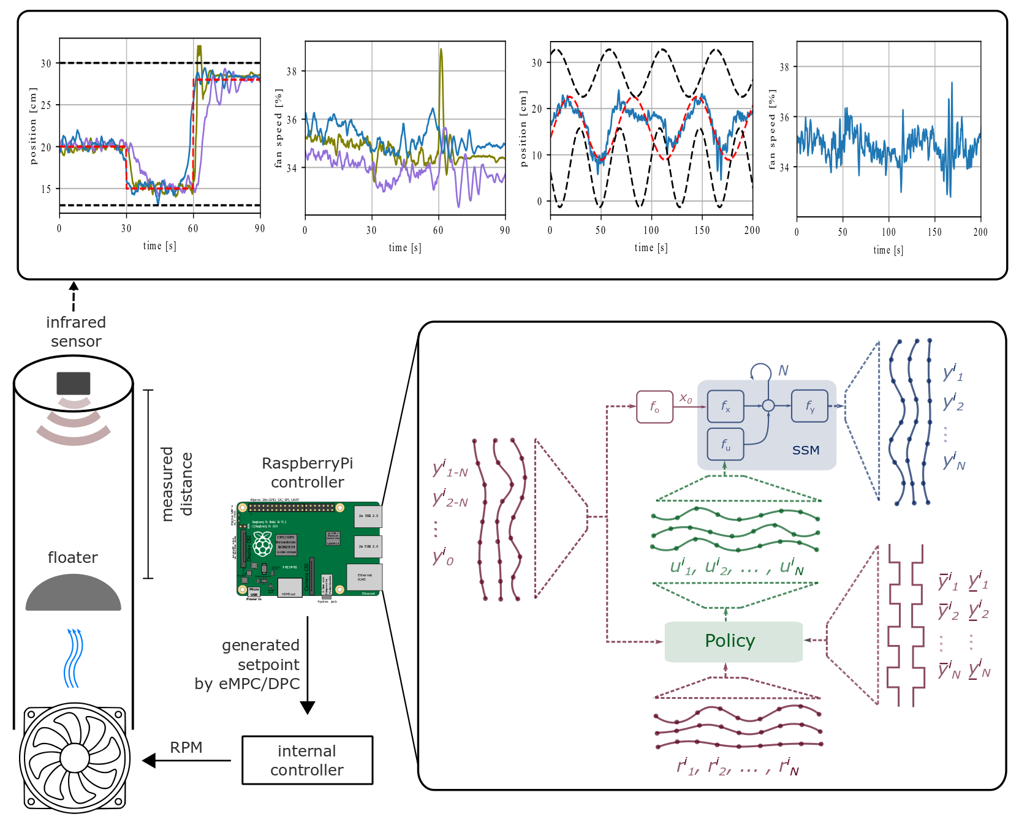
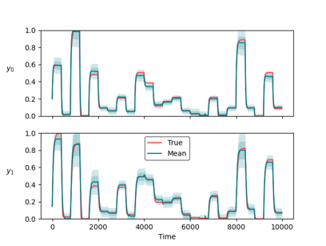
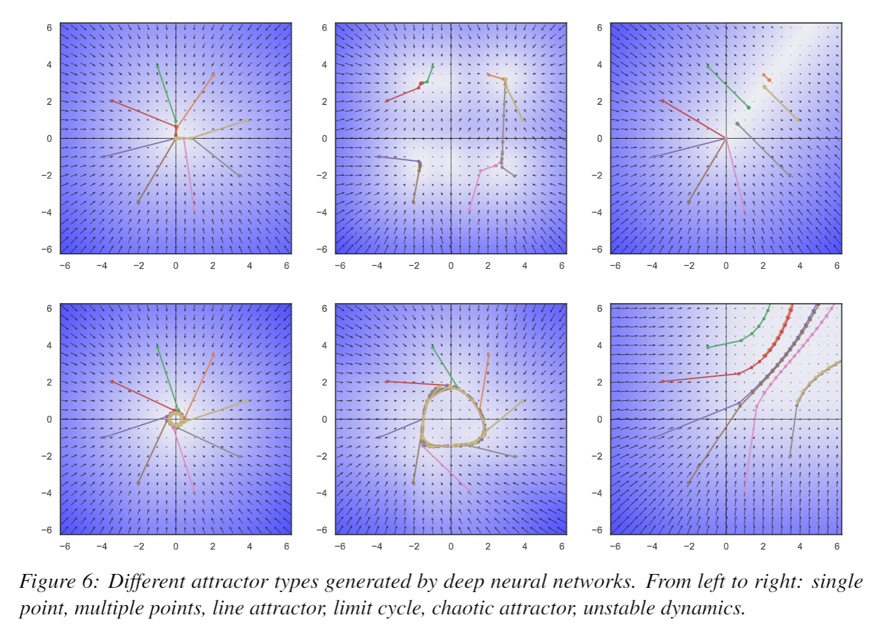
Conclusion
Differentiable Predictive Control
Neural state space model for system ID
Physics-informed priors (neural gray-box)
Incorporating operational constraints
Theoretical connection with MPC
Explicit neural control policies
Embedded implementation with low-cost HW
Learning from small datasets
Ongoing work
Uncertainty Quantification
User-friendly software package
Pytorch-based will be released soon: https://github.com/pnnl/neuromancer
Comprehensive suite of physics-based priors and constraints
Structured linear maps in Pytorch: https://pnnl.github.io/slim/
Theoretical guarantees: convergence, stability, constraints satisfaction
Long-Term Vision
Causal discovery, dynamical coupling
Solving large-scale non-convex constrained optimization problems
Real world applications in energy, manufacturing, cyber

